Slide 1
BIS 403 - Applied Systems Design College: Peirce College Professor: Robert Heubner Group Members: J. Sherif & M. Morrison Case Study: Personal Trainer Case Study #8
Date: 2/11/2024
Tasks 1&2, completed by Jilalo Sherif
Tasks 3&4, completed by Morrese Morrison

Slide 2
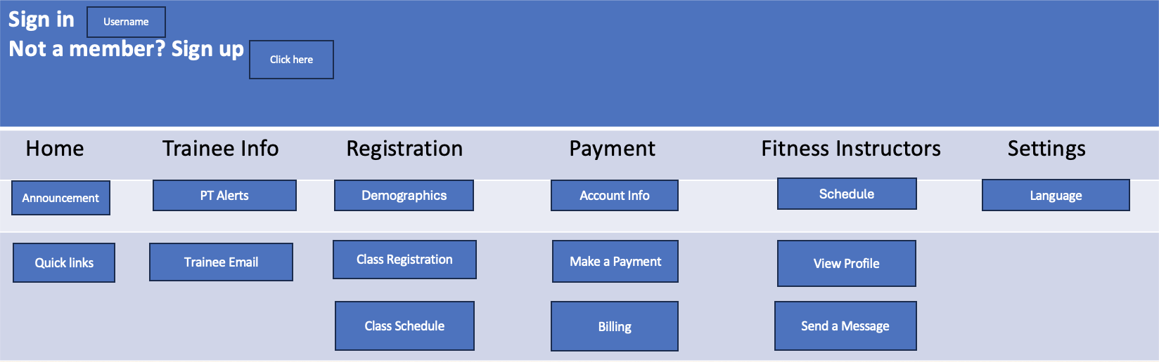
Personal Trainer Switch Board

Slide 3
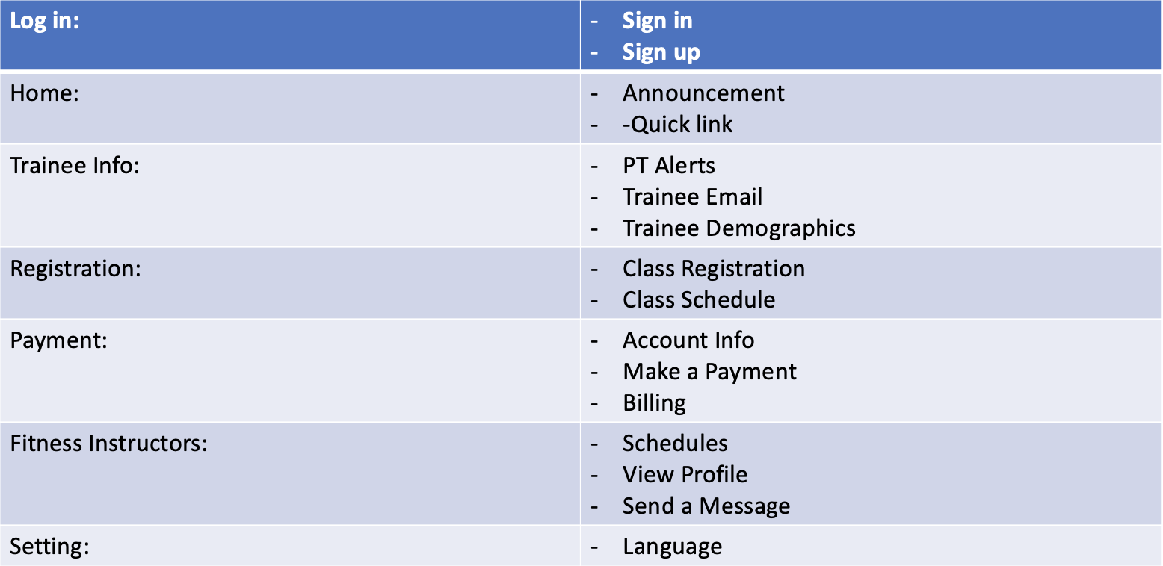
Personal Trainer Storyboard

Slide 4
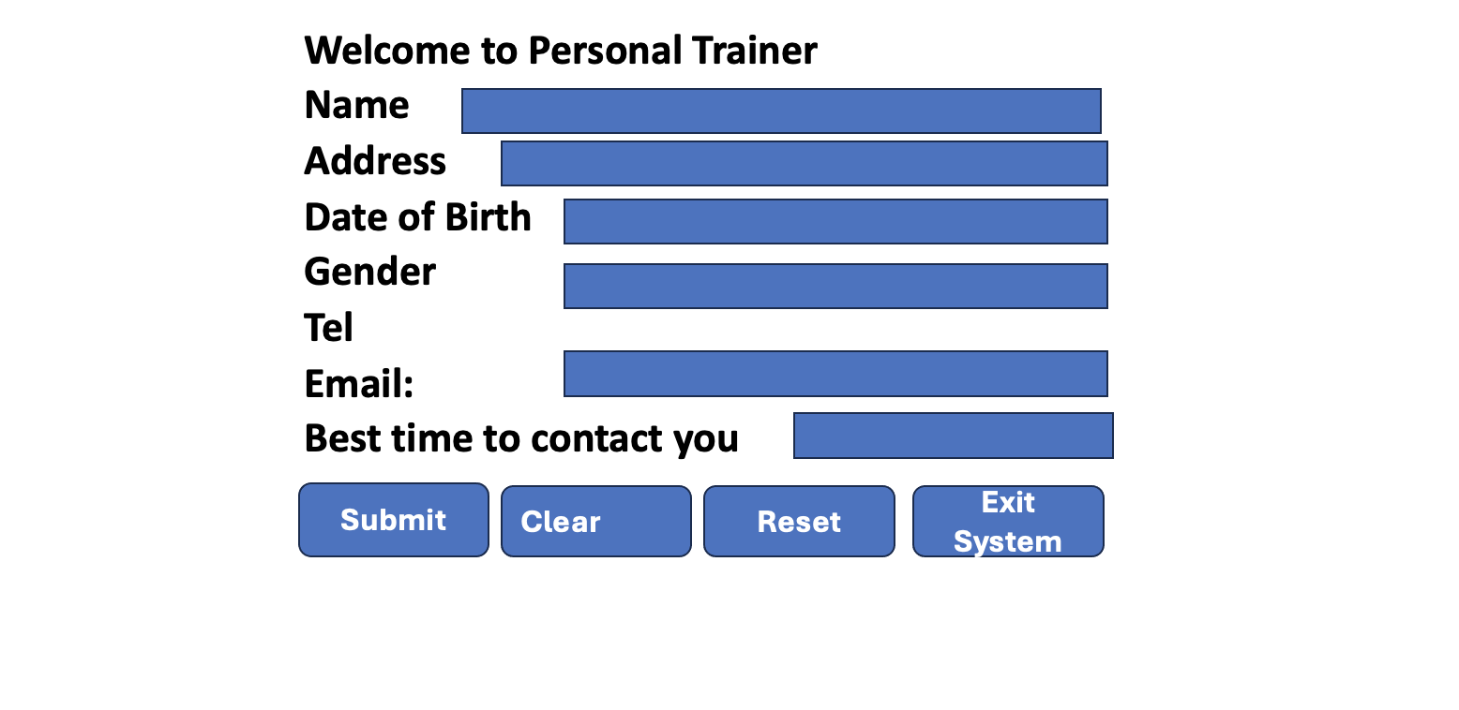
Personal Trainer Online Registration Form

Slide 5

Paper Source Document (Fitness Class Sign Up)

Slide 6
BumbleBee Software Data Protection & Security Controls (Memo)
DATE: 2/11/2024
TO: Gray Lewis & Personal Trainer Staff
FROM: Susan Park
SUBJECT: Bumblebee Software Data Protection & Security Controls
Greetings Personal Trainer Staff,
In today’s business environment, the protection and control of data is paramount to an organization's daily operation. Also, with businesses utilizing a technologically centric approach to the input, output, and storage of this data, it is even more imperative that this data is controlled and accurate. Listed below are the various controls and policies that will be implemented in order to adhere to the fundamental principles of data security in a modern business environment.
Input Security Controls
Data Entry Audit Trail - Each time data is entered into the system, an audit log line will be recorded that shows what was entered, by whom, the date and time, as well as how long the user took to enter that data.
Input Access - All users have the ability to input data within the system. This input will be reconciled daily for accuracy.
Output Security Controls
Report Generation & Printing - Printing & Scanning can only be completed within the facility secure team member office. Each report that is generated and printed is tracked. Financial and payroll reports are only accessible to the facility’s manager and can not be printed. Only read. Other reports such as sales transactions and membership information can be viewed and printed. Print counts will be enabled on each report to limit the amount of physical copies that can be accessible at once.
Removable Devices & External Access - It is prohibited to move company reports to external hardware such as a flash drive. It is also prohibited to store any company reports on a team member’s email account or cloud storage service. The only email domain that is accessible will be Personal Trainer’s. Also the only cloud storage service that will be available is google drive. External USB ports will be blocked to prevent any intrusions from threat actors as well as deter the transfer of company information on to an external USB drive.
Data Security Policies
Record Retention Policy - All physical records of all transaction will be digitally scanned and saved to the facilities designated file share drive. These records will then be backed up and stored in Personal Trainer’s AWS S3 bucket for future reference if needed. Records up to one year will be accessible on the file share drive. After one year, all records will be cleared. The facilities admin will be responsible for all scanning and data entry.
Physical Transaction Destruction - Once a record is scanned, place the physical document in side of the manager’s office in the designated physical destruction bin. After each day, the facility manager will be responsible for shredding all of the documents that are placed in the bin.
Identity Access Management - Access to the various reports and information provided within the BumbleBee Software System will be based off of Security Groups that are assigned to the facility employee. There will be four levels of access, Level 1 (Facility Sales Clerk), Level 2 (Facility Admin), Level 3 (Facility Trainer), Level 4 (Facility Manager). These levels of access correspond to the job roles that each team member may have.

